Slide 1
How the Car Industry Has Evolved Over the Past Decades
Zhan Xin Wang

Slide 2
Project Overview
Analyze how the U.S. car industry has changed over recent decades
Focus on:
  Vehicle Consumer Price Index (CPI)
  Fuel price trends
  EV adoption patterns
All data cleaning, analysis, and plots are available in my GitHub repo

Slide 3
Data Sources
BLS (Bureau of Labor Statistics): Vehicle CPI
EIA (Energy Information Administration): U.S. fuel prices (Excel file)
AFDC (Alternative Fuels Data Center): State EV registrations (2023 snapshot

Slide 4
Data Wrangling Summary
Cleaned messy headers and metadata rows
Identified correct worksheet in EIA Excel (“Data 1”)
EV dataset required restructuring to extract total EV counts by state
Final cleaned files are published in GitHub:
  cpi_vehicles_clean.csv
  fuel_prices_clean.csv
  ev_adoption_clean.csv

Slide 5
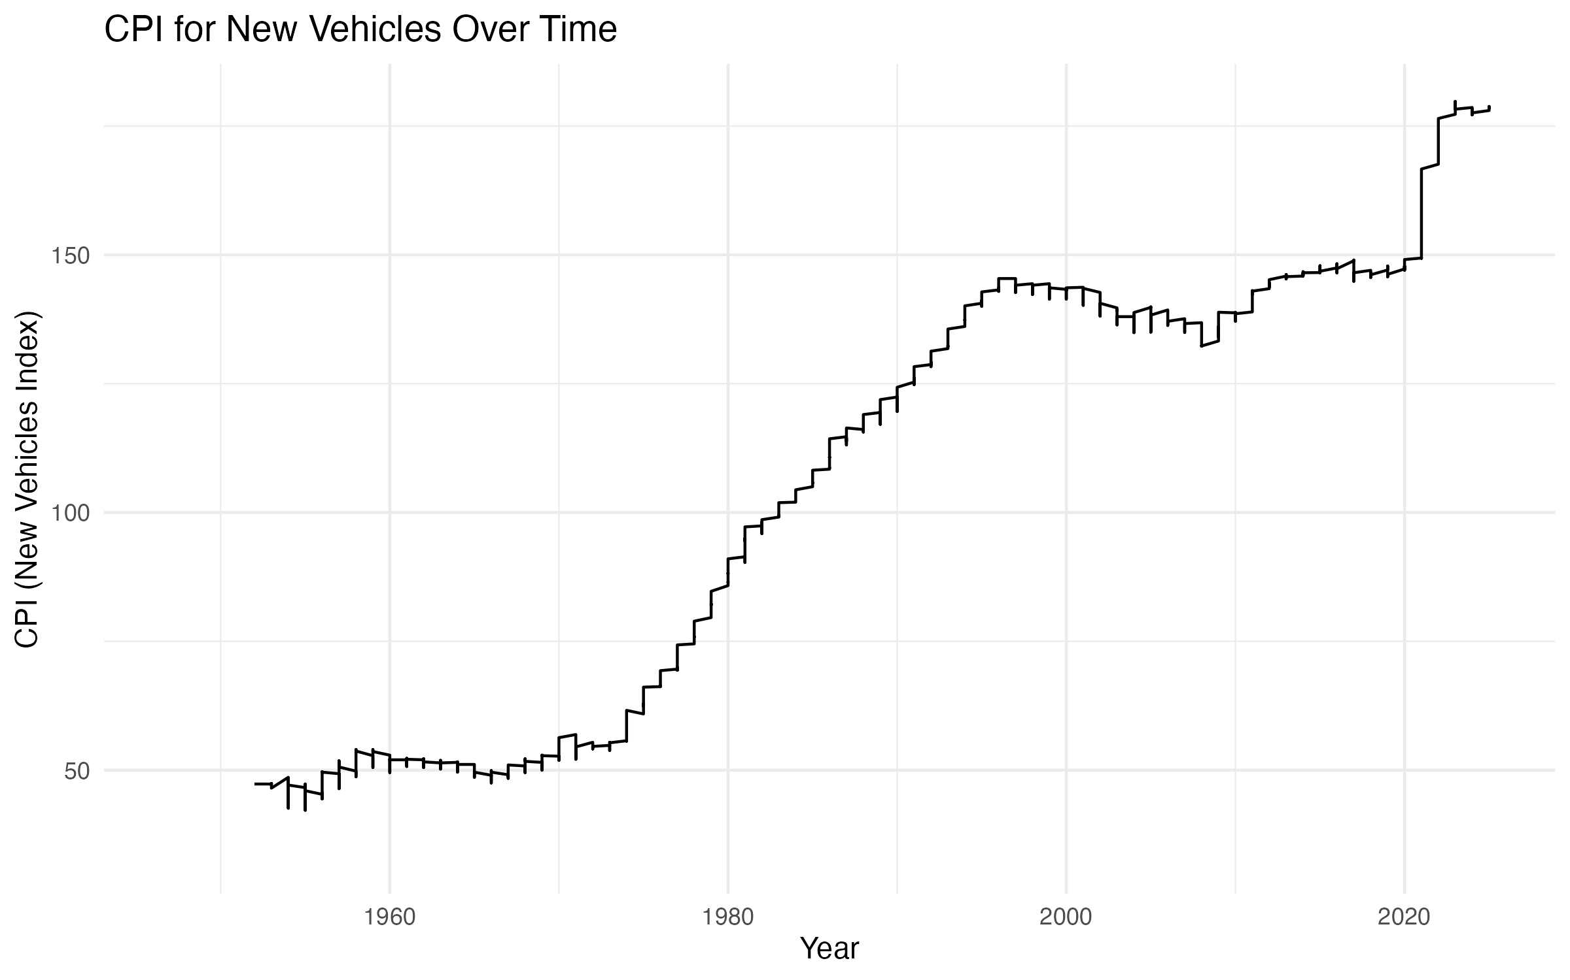
Vehicle CPI Trend
What it shows:
Vehicle prices have gradually increased over decades
Reflects inflation, production cost increases, and market shift toward SUVs

Slide 6
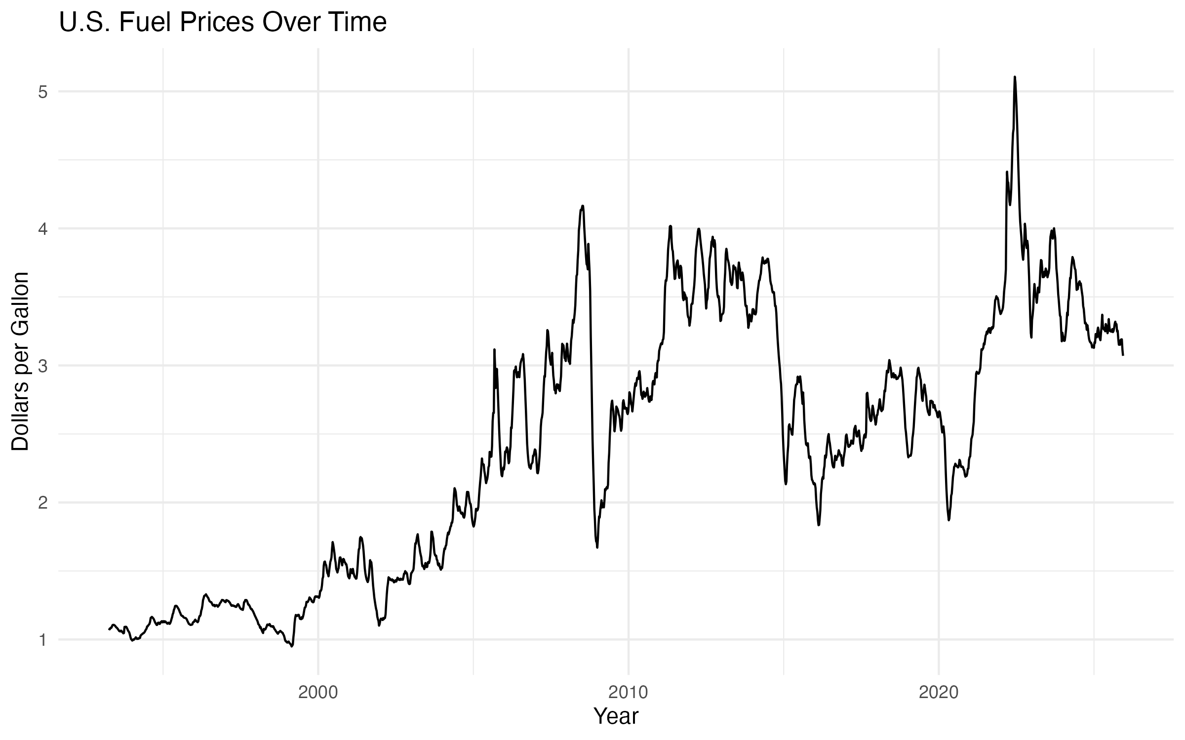
Fuel Price Trend
What it shows:
- High volatility in gasoline prices
- Major peaks around 2008 and 2011–14
- Recent increases influenced by inflation and supply shocks

Slide 7
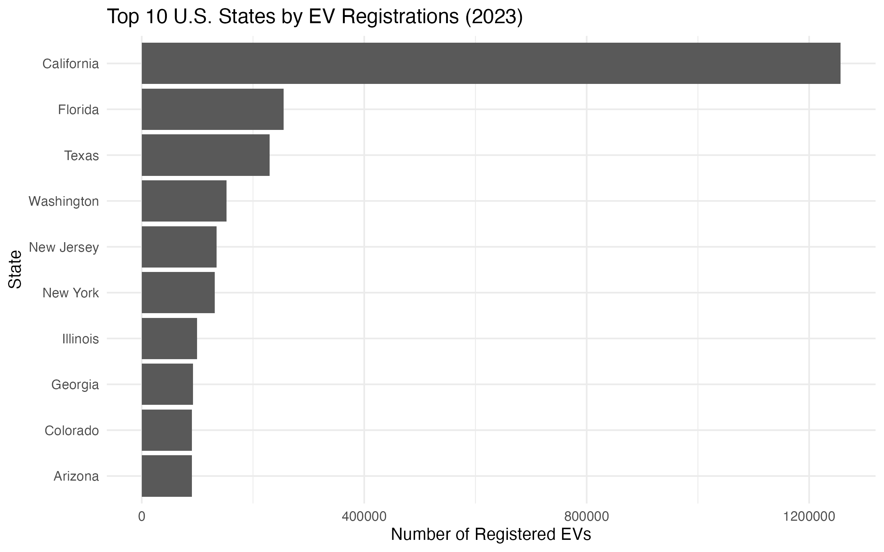
Column graph
What it shows:
-California dominates EV adoption
-Other leading states: Florida, Texas, New York, Washington
-Dataset is a one-year snapshot, not a time series

Slide 8
Key Takeaways
Vehicle prices are rising steadily
Fuel prices are unstable, pushing interest toward alternatives
EV adoption is growing, but uneven across states
Industry is shifting toward electrification, influenced by energy costs and policy incentives

Slide 9
Thank You
Bureau of Labor Statistics (BLS)
Consumer Price Index for New Vehicles (CUUR0000SETA01)
https://www.bls.gov/cpi/
U.S. Energy Information Administration (EIA)
U.S. Retail Gasoline & Diesel Prices (Excel Datasheet)
https://www.eia.gov/petroleum/gasdiesel/
Alternative Fuels Data Center (AFDC)
Electric Vehicle Registrations by State (2023)
https://afdc.energy.gov/data/

